Slide 1

Basic Details of the Team and Problem Statement
Ministry/Organization Name/Student Innovation: Department of Space, Indian Space Research Organisation (ISRO)
PS Code: SS588
Problem Statement Title: To identify the monuments from Satellite Images using Deep Learning and Integration of Interpretability for the predicted outcomes (Explainable AI
Team Name: The Monumentals
Team Leader Name: Adarsh Shetkar
Institute Code (AISHE):
Institute Name: Chaitanya Bharathi Institute Of Technology
Theme Name: Miscellaneous

Slide 2
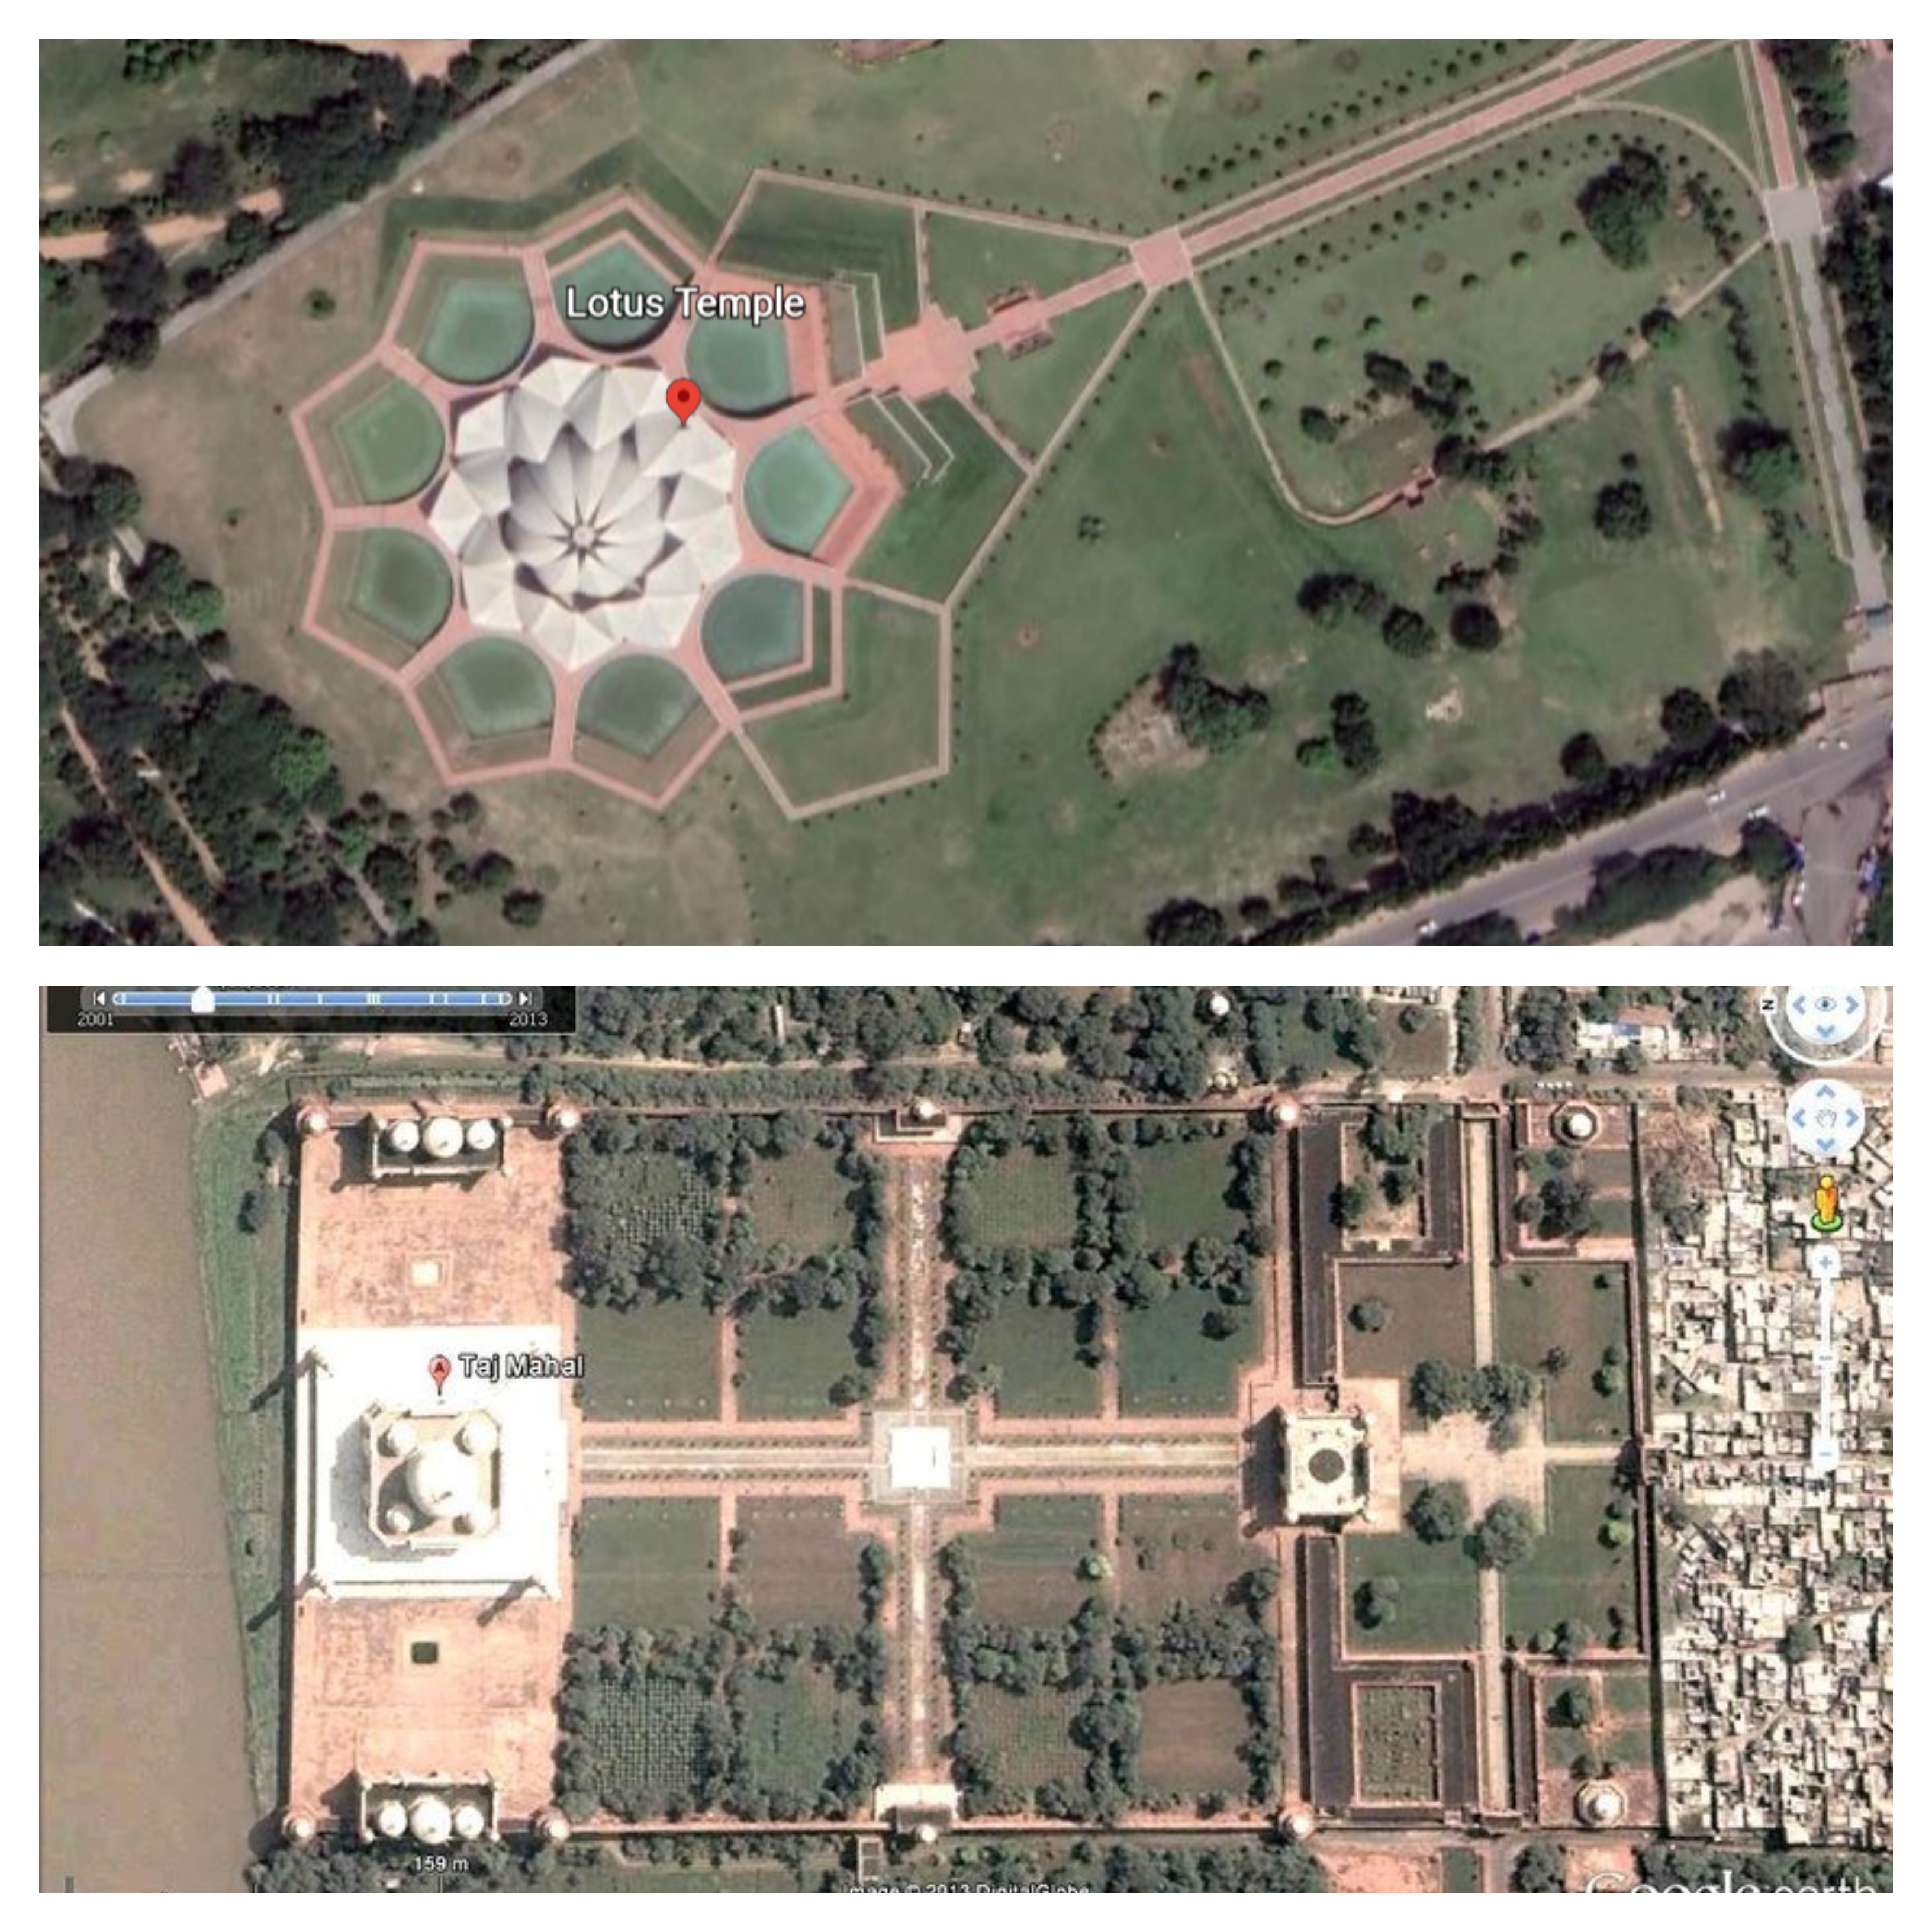

Idea/Approach Details
Add process flow chart or simulated image of prototype or any relevant image related to your idea
Describe your idea/Solution/Prototype here:
A custom-built web application, through which manually satellite images of monuments can be uploaded.
The images are classified using a supervised deep learning algorithm called Multilayered Perception Classifier (MLPClassifier).
Interface for the prototype includes Streamlit.
The model creation as a back-end includes Google-collab via google-drive.
Describe your Technology stack here:
Google-drive
Google-collab
Python libraries
Sci-kit learn (module for ML/DL)
Artificial Neural Networks(MLPClassifiers)
StreamLit
2

Slide 3
Idea/Approach Details
Describe your Use Cases here
Describe your Dependencies / Show stopper here
⮚Military Systems
⮚Medical fields
⮚Computer vision
⮚Traffic control systems
⮚Security systems
⮚Manufacturing industries
3

Slide 4
Team Member Details
Team Leader Name: Adarsh Shetkar
Branch (Btech/Mtech/PhD etc): Btech Stream (ECE, CSE etc):IT Year (I,II,III,IV): II
Team Member 1 Name: Sifathjeet Singh Bhatia
Branch (Btech/Mtech/PhD etc): Btech Stream (ECE, CSE etc): IT Year (I,II,III,IV): II
Team Member 2 Name: Manoj Kumar Paliviri
Branch (Btech/Mtech/PhD etc): Btech Stream (ECE, CSE etc): IT Year (I,II,III,IV): II
Team Member 3 Name: Sai Sarath Chandra Kavuluru
Branch (Btech/Mtech/PhD etc): Btech Stream (ECE, CSE etc): IT Year (I,II,III,IV): II
Team Member 4 Name: Kashyap Reddy Nangi
Branch (Btech/Mtech/PhD etc): Btech Stream (ECE, CSE etc): IT Year (I,II,III,IV): II
Team Member 5 Name: Mansi Lakshmi Gidugu
Branch (Btech/Mtech/PhD etc): Btech Stream (ECE, CSE etc): IT Year (I,II,III,IV): II
Team Mentor 1 Name: Type Your Name Here
Category (Academic/Industry): Expertise (AI/ML/Blockchain etc): Domain Experience (in years):
Team Mentor 2 Name: Type Your Name Here
Category (Academic/Industry): Expertise (AI/ML/Blockchain etc): Domain Experience (in years):

